Slide 1

Advanced x86: BIOS and System Management Mode Internals SPI Flash
Xeno Kovah && Corey Kallenberg
LegbaCore, LLC

Slide 2
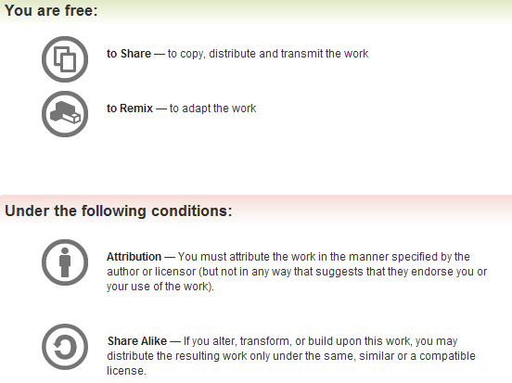
All materials are licensed under a Creative Commons “Share Alike” license.
http://creativecommons.org/licenses/by-sa/3.0/
Attribution condition: You must indicate that derivative work
"Is derived from John Butterworth & Xeno Kovah’s ’Advanced Intel x86: BIOS and SMM’ class posted at http://opensecuritytraining.info/IntroBIOS.html”
Notes:
Attribution condition: You must indicate that derivative work
"Is derived from John Butterworth & Xeno Kovah’s ’Advanced Intel x86: BIOS and SMM’ class posted at http://opensecuritytraining.info/IntroBIOS.html”

Slide 3
BIOS Flash Overview
Everything we have talked about so far, although harmful to a system, isn’t persistent unless you can write to the BIOS
But one of the goals an attacker has in establishing a presence in the system is persistence
To achieve persistence, the attacker will have to figure out a way to write to the BIOS flash so that upon every reboot, his presence is still there

Slide 4
Results of Copernicus checks
We’ve used Copernicus to scan all of MITRE, and some other organizations.
Originally (in 2013) the data said about 35% of systems were vulnerable.
Then we found more problems and it went up to 55%
Then people patched and it went down to 35%
Then we found more problems and it went up to 60%
Then we found more problems and it went up to 85%
And if the organizations had never patched, and we looked at our first data with our last knowledge?
99.95% vulnerable

Slide 5
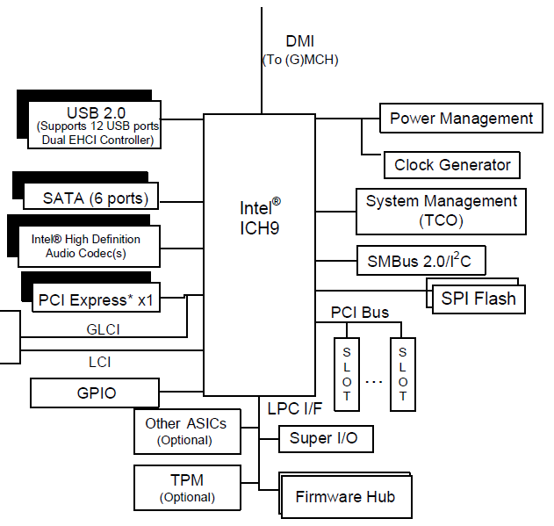
BIOS Flash Location
BIOS can reside in one of 3 locations:
Firmware Hub (FWH)
Older technology and mostly out of scope for this class
SPI Flash
Most likely location
PCI
intended for debugging or recovering from a corrupted BIOS (not supported anymore on newer hardware)

Slide 6
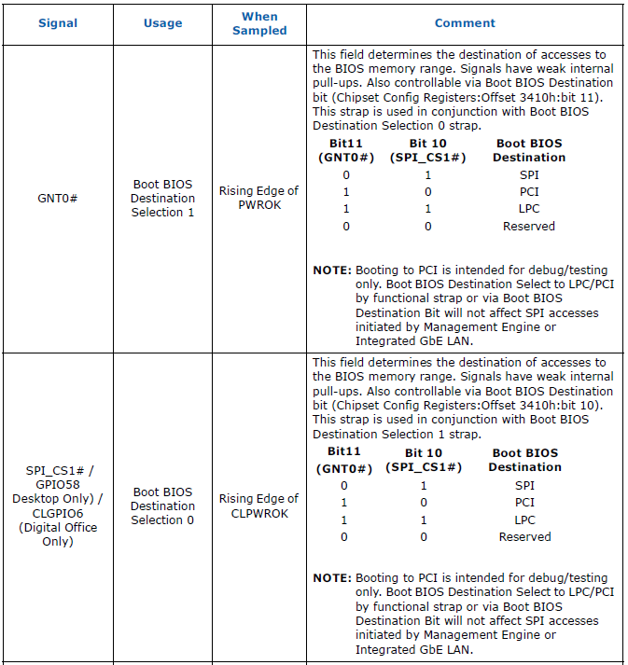
Boot BIOS Flash Location
The boot destination is decided by the configuration of the following pins on the ICH/PCH*
Pins are sampled at power-up to determine location of BIOS
Intended for static configuration
PCI boot is intended only for debugging or recovering from corrupt BIOS (so not necessarily static)
But since these are hardware pins, it’s worth checking if PCI is set as the boot location, because you might have a physical hardware implant!
* References to ICH/PCH mean applicable to both legacy and modern chipsets

Slide 7
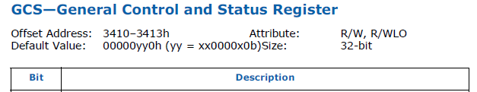
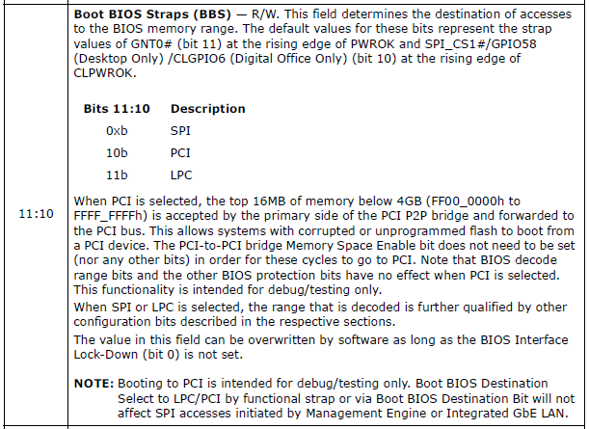


Example: Find BIOS Boot Destination
To programmatically find where your BIOS is configured to boot from, you can also view bits 11:10 in the General Control and Status Register (GCS)
Located at memory-mapped offsets 3410-3413h in the Chipset Configuration Registers
Chipset Configuration Registers are mapped starting at the address held by RCBA…you know, RCRB? :)
01b SPI (typo in datasheet)
Verify GCS location on your datasheet if not using the class E6400.

Slide 8
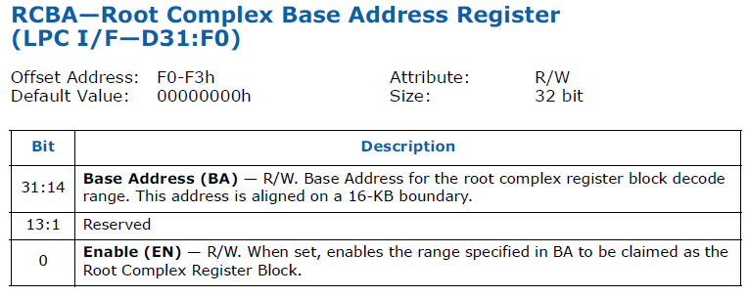
Reminder: RCBA/RCRB
You know the drill!
The Root Complex Register Block (RCRB) decode range is located in the Root Complex Base Address (RCBA) register located in the LPC (D31:F0, offset F0-F3h)
The root complex is PCI-Express related. It connects the processor and memory to the PCI Express devices.
If you want to know more about the inner workings of PCI Express, there are a number of good sources, such as (Darmawan):
http://resources.infosecinstitute.com/system-address-map-initialization-x86x64-architecture-part-2-pci-express-based-systems/

Slide 9
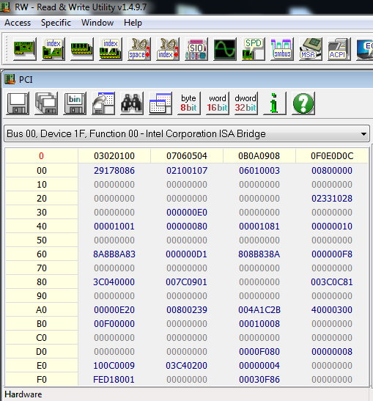
Example: Find BIOS Boot Location
Locate RCRB:
Bit 0 is just an enable bit (the nibble this bit is in is still part of the address, but change it to 0)
Here the RCRB begins at FED1_8000h
The GCS register is located at in the chipset configuration registers.
At RCRB + 3410h = FED1_B410h
The root complex base address will differ on different systems.
Notes:
If you answer “undetermined”, pat yourself on the back and move to the next slide. If you said what the bits indicate well you are still probably correct.

Slide 10
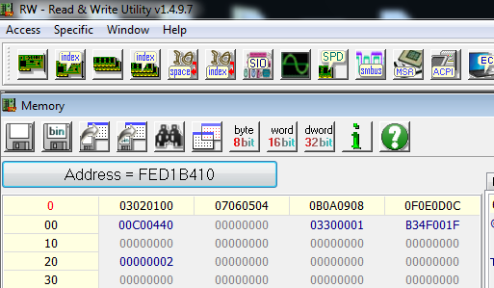
Example: Find BIOS Boot Location
GCS at FED1_B410h yields the following value on our lab system:
00C0_0440h
Bits 11:10 are 01b which indicates that this BIOS boots from SPI
But how can we trust what this says? We’re not actually sampling the Controller’s pins in this register
Bits 11:10
Notes:
If you answer “undetermined”, pat yourself on the back and move to the next slide. If you said what the bits indicate well you are still probably correct.

Slide 11
Example: Change BIOS Access Destination
Notice these bits are R/W?
You can change the destination for BIOS accesses
Likely this is to help the system recover from a corrupted BIOS
But it could be certainly misused as well
Note just to be clear: The bits in GCS alter accesses to the BIOS *only* after the BIOS has begun booting
Chipset Configuration registers must be mapped to memory, etc.
The functional straps are physical pins which cannot be altered and decide the BIOS Boot Location

Slide 12
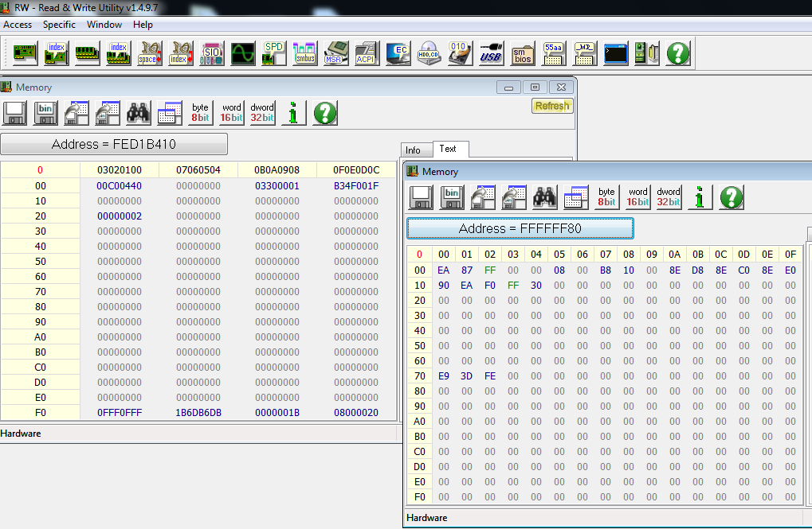
Example: Change BIOS Access Destination
Bring up a memory window and go to an address which shows the memory-mapped BIOS (like FFFF_FF80h which will show us the entry vector)
You should see the BIOS in memory

Slide 13
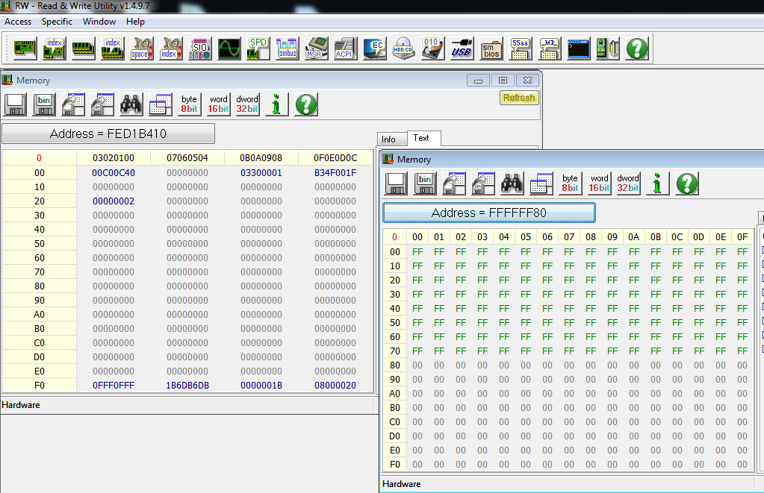
Example: Change BIOS Access Destination
Modify the GCS register to 00C00C40h, bits 11:10 are 11b now which point the device to the LPC
On our lab system the LPC has no firmware BIOS so this translates to reads of all 1’s (0xFF)
Your personal system may differ and you may actually see valid binary here.

Slide 14

Example: LOCK BIOS Access Destination
Intel provides a way to lock down the destination of BIOS accesses
When bit 0 in the General Control and Status Register (GCS) is set, bits 11:10 become Read-Only
The BIOS should lock this down!

Slide 15
Example: Change BIOS Access Destination
Set bits 11:10 in the GCS register back to their original values (01b for SPI)*
Assert bit 1 in GCS, now GCS is 00C00441h
Now find that bits 11:10 are fixed in place
*Or leave them pointing to nothing, this is not permanent and nothing a reboot won’t reset

Slide 16
A Word About This
This only affects direct (memory) accesses to BIOS flash
Programs (like Copernicus or Flashrom) that read directly from the BIOS flash using the SPI programming registers (for example) will still successfully read the BIOS binary from the chip
Notes:
When we program the SPI registers, we aren't accessing that memory-mapped space. We are reading data in and out of a buffer, accesses to that buffer do not derive from the memory-mapped range.

Slide 17
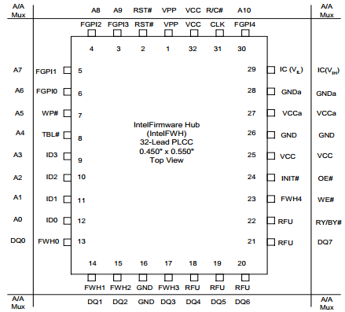
Firmware Hub (FWH)
Provides register-based R/W protection for each code/data storage block
Has hardware write-protect pins for the top boot block and the remaining code/data storage blocks
Contains a Random Number Generator (RNG)
More than one FWH device can be supported
Operates at 33 MHz (synchronous to the PCI bus)
Has a lot of pins compared to SPI
Intel 82802AB/82802AC Firmware Hub (FWH)

Slide 18
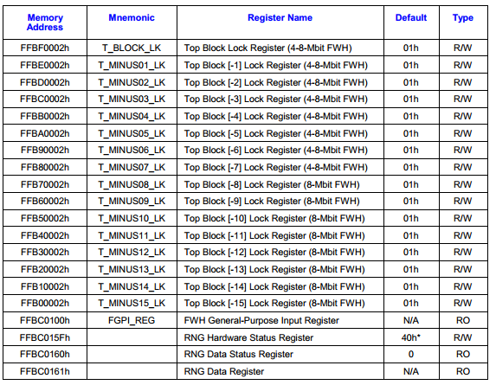
Firmware Hub (FWH)
Memory-mapped interface
Programmable Erase, Read, Write commands
Each block can be locked down to prevent Reads and/or Writes
Firmware hubs are rare (at least in modern PC’s) and we have never seen one
Sample FWH datasheet:
http://download.intel.com/design/chipsets/datashts/29065804.pdf
If you ever encounter a system with a firmware hub email me and tell me the make/model please
Intel 82802AB/82802AC Firmware Hub (FWH)

Slide 19
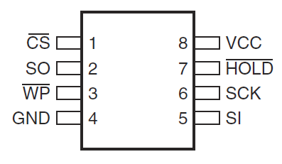
Serial Peripheral Interface (SPI)
Intel’s ICH/PCH implements a SPI interface for the BIOS flash device
Used as a replacement for the Firmware Hub (FWH) on LPC
SPI is required in order to support the Management Engine (ME), Gigabit Ethernet (GbE), and others.
Each SPI flash device can be up to 16 MB (2²⁴ bits)
Typically 8 pins, can be 16
SPI controller can support 1 or 2 devices for 32 MB maximum addressable space
Lower cost alternative (per Intel datasheet)
Memory-mapped programming interface offset from RCRB (consult your datasheet for its exactly offset)
*Based on datasheet information and that the Flash Address Register accepts addresses occupying bits 24:0

Slide 20
SPI Overview
SPI protocol can support data rates up to 100 MHz
Intel’s implementation is configurable to operate at either 20 MHz or 33 MHz (or 50 MHz on the newer PCI Express systems), or 66MHz
Intel abstracts most of the low-level SPI protocol from you
SPI protocol is not a fixed standard
Different chips will support different commands and so forth
Intel defines a set of minimum requirements for a chip to support.
Likely though each chip will support more than just that bare minimum
So we’ll be covering Intel’s implementation and interface to SPI, not really the SPI protocol itself (they intertwine somewhat of course).

Slide 21
SPI Operating Modes
Since I/O Controller Hub version 8, the SPI flash has been able to support 2 distinct operating modes:
Non-Descriptor Mode (RIP, deceased ’09)
IT LIVES! (On embedded Intel Atom devices like MinnowBoard!)
In ICH7 this is the only supported operating mode
Descriptor Mode
Since ICH8 (so ICH8, ICH9, ICH10, and PCH)
For systems that have a Platform Controller Hub device (PCH), non-descriptor mode has been phased out and is no longer supported
Notes:
I know I read something to this effect, need to find it.

Slide 22
Descriptor Mode
Enables chipset features like:
Integrated Gigabit Ethernet, Host processor for Gigabit Ethernet Software, Management Engine
Provides support for two SPI flash chips
Divides the SPI flash into regions
Provides hardware enforced security restricting region access
Chipset Soft Strap region provides the ability to use Flash NVM as an alternative to hardware pull-up/pull-down resistors for both ICH and PCH
On reset, the controller hub reads the soft strap data out of the SPI flash
Can be programmed (at a minimum) using the commands specified in the Intel ICH/PCH datasheet
But each chip can support additional commands, not very standardized
Notes:
*** Ok that;s interesting…
**** Standardized – the JEDEC ones?

Slide 23
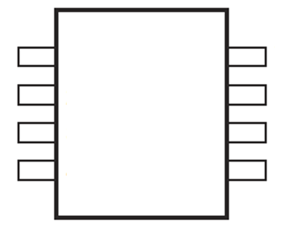
Memory Mapping: Descriptor Mode
4GB
All of the flash chip is mapped to high memory
In Descriptor Mode, only the BIOS region of the flash is readable in memory
All other regions return 0xFF on reads
We'll get to the other regions in a bit
BIOS Region
Memory
Flash Contents
Flash contents that are viewable in Memory

Slide 24
Non-Descriptor Mode
Best described by its lack of features (as compared to Descriptor mode)
The entire flash is used for BIOS (this does not mean the BIOS will be larger)
Security features available in Descriptor mode are not available in Non-Descriptor mode
The BIOS/CPU can read/write to the flash without restriction
Therefore there is also no support for Gb Ethernet, Management Engine, or chipset soft straps
Interesting quote in Intel’s ICH datasheet (10, in this case): “[in Non-Descriptor Mode], Direct read and writes are not supported.”
‘Non-Descriptor Mode == !Descriptor Mode’
No longer a viable option on the newer PCH systems, since they require a valid flash descriptor

Slide 25
Memory Mapping: Non-Descriptor Mode
4GB
4GB – size of flash (MB)
In Non-Descriptor Mode the entire flash contents are visible in memory (more than just BIOS, if any more is present)
If flash is < 16 MB and the FWH decoders are enabled in LPC, you will see the BIOS mapped repeatedly (think ribbons) at high memory
A 4MB BIOS is mapped 4 times in the high 16 MB of memory space
A flash device in descriptor mode that has its descriptor signature “corrupted” will be viewable in memory in its entirety
But the descriptor signature is protected, so that would require physical flash access to corrupt
4GB – 16 MB
Entire Flash
Memory
Flash Contents
Flash Contents Readable in Memory
Notes:
But note that you shouldn't be able to corrupt the descriptor for the OS, since it *should* be unconditionally write protected on any correctly configured system (I don't think we've found any that have vulnerable descriptors)

Slide 26
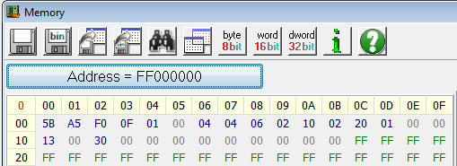
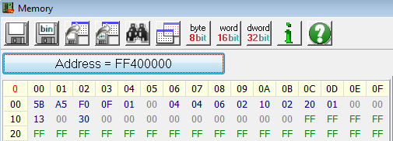

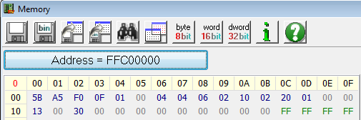
Non-Descriptor Mode Memory Mapping
Example of 4 MB device in “non-descriptor” mode mapped to high 16MB of memory
“Invalid” Flash Descriptor
0FF0A55Bh
instead of 0FF0A55Ah

Slide 27
Why is some of the chip visible in memory in one mode but not the other?
Has to do with the type of flash access as well as permissions to read that memory:
There is an SPI “rule” that states:
Every SPI Master has direct read access to it’s own region only
Direct Access refers to memory reads in mapped memory
Thus the BIOS Master can read the BIOS region in memory (mapped to high mem at 4 GB)
In Descriptor mode, the SPI flash is divided into regions
BIOS region, Flash Descriptor, etc. (we’ll cover in more detail soon)
Therefore, in Descriptor Mode, only the BIOS region can be seen in high mapped-memory
In Non-Descriptor mode, there is no concept of regions
It’s just “the BIOS”
So therefore, the entire “BIOS” (entire flash) can be seen in memory when the SPI flash is in Non-Descriptor mode

Slide 28
Flash Accesses: Direct vs. Register
Direct Access
This applies to memory accesses (mapped to high-memory)
Masters are allowed to read only their own region
CPU/BIOS can read the BIOS region
Management Engine can read only the ME region
GbE controller can read the GbE region (GbE software must use the programming registers)
Register Access
Access a region by programming the base address registers
Register accesses are not allowed to cross a 4 KB aligned boundary
Cannot execute a command that may extend across to a second SPI flash (if present)
Software must know the SPI flash linear address it is trying to read
Notes:
(this slide seems duplicative? May delete)
When you read the flash that is mapped to upper 4GB of memory, this is direct access.
We will get into actual SPI programming in a future Advanced class, for now we just want to understand that there is an interface and how to use some pre-made tools for forensics analysis
*** Is it the flash controller that limits this? Or the ICH decoder?

